Slide 1
Writing an Effective NCUR Abstract
Amy M. Buddie, PhD
Director, Office of Undergraduate Research
Christopher T. Cornelison, PhD
Associate Director, Office of Undergraduate Research
Emily Deibler
Graduate Intern, Office of Undergraduate Research

Slide 2
What is Undergraduate Research?
From the Council on Undergraduate Research (CUR):
“An inquiry or investigation conducted by an undergraduate student that makes an original intellectual or creative contribution to the discipline.”
http://www.cur.org/who/organization/mission/
Also:
Mentored by a faculty member
Disseminated to the academic community (presentation/ publication)

Slide 3
What is an Abstract?
A short (300-word max) summary of your research project
Purpose:
  Helps reviewers decide if your project represents a quality research project that should be presented at the conference
  Helps conference attendees decide if they want to go to your presentation
  Intrigues the reader about your research/creative activity
The NCUR 2019 guidelines can be found here: http://www.cur.org/what/events/students/ncur/2019/ncur_2019_abstract_guidelines/

Slide 4
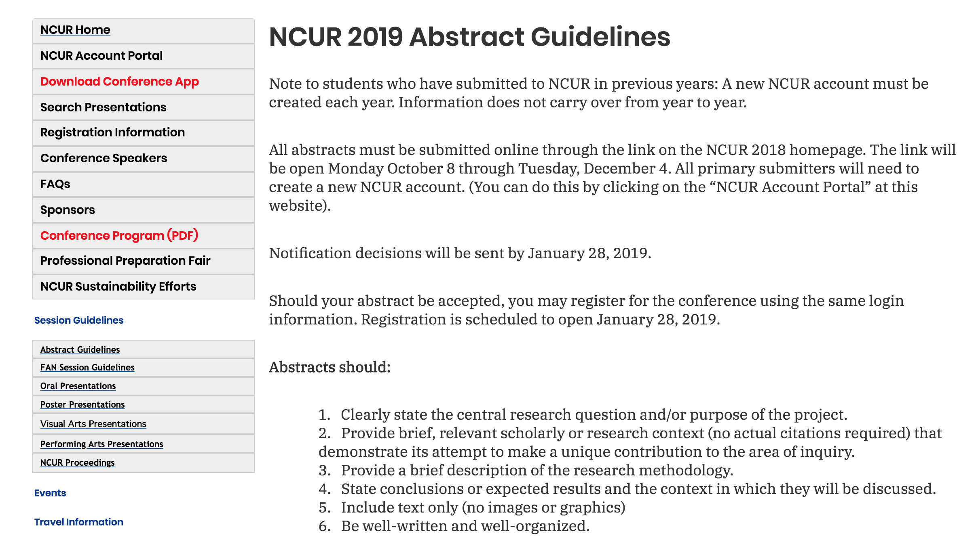
Free registration if you are accepted; do not register until you receive instructions

Slide 5
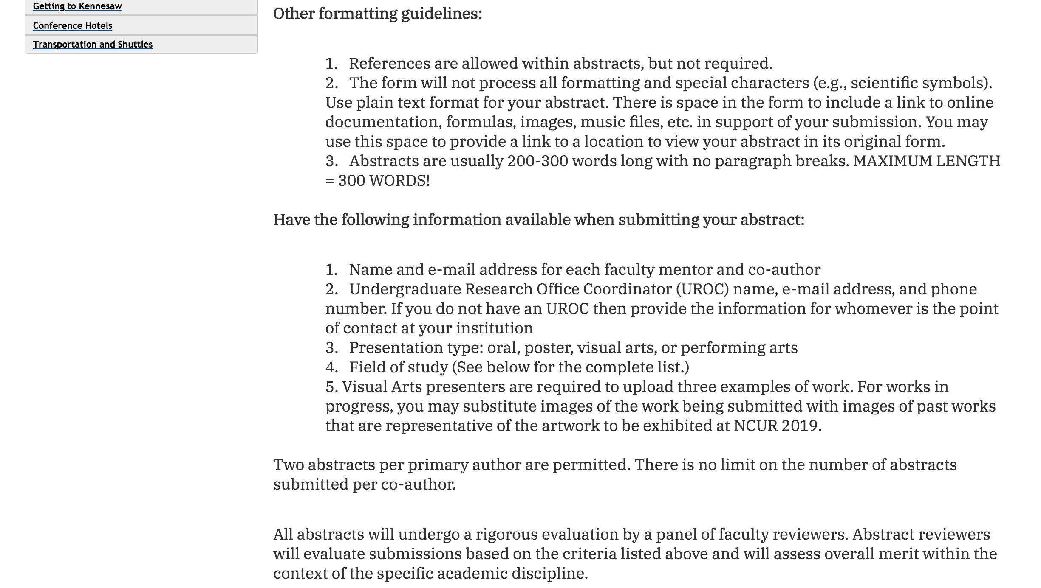
Double-check the spelling of all email addresses!
UROC is Amy Buddie, abuddie@kennesaw.edu, 470-578-6255

Slide 6
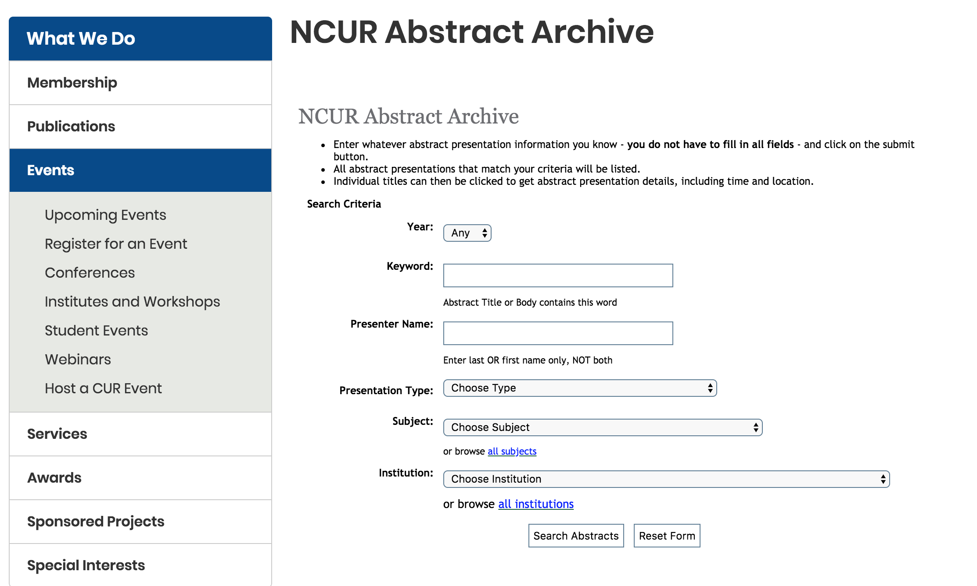
http://www.cur.org/what/events/students/ncur/past/abstracts/

Slide 7
Some Samples…

Slide 8
Sociology

Slide 9
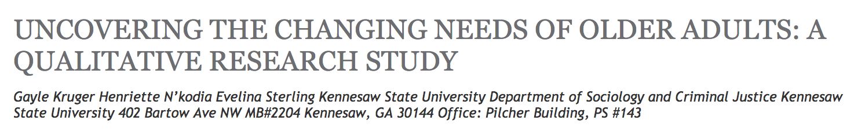
Atlanta, like the rest of the U.S., is experiencing a dramatic increase in its older adult population; by 2030, one in five residents will be over the age of 60. Recognized as a leading county-based senior service agency in metropolitan Atlanta, Cobb County Senior Services provides an array of aging services including multipurpose centers, volunteer and advocacy opportunities, resource development, and innovative partnerships. Due to the many challenges presented by the growth of the older adult population, Cobb County Senior Services is currently embarking on the development of a strategic plan to best meet the changing needs of older adults over the next 25 years. However, in research as well as in practice, older adults are commonly excluded, marginalized or treated less than fully competent adults. Further complicating matters, many deny old age and their fears concerning declining capacities as well as becoming dependent (or a burden). The overall purpose of this initial qualitative research is to 1) Accurately determine the interests and concerns of the aging population eligible for support and services from Cobb County Senior Services over the next 25 years and 2) Identify opportunities and barriers to researching older adults in Cobb County. Data will be collected and transcribed from five focus groups (consisting of 8-12 participants each) conducted throughout Cobb County, taking into account gender, racial, ethnic, geographic, class, and age-related differences. Conclusions will include specific issues, connections, and trends regarding key categories such as housing, employment, civic engagement, health, preventative health, physical activity, nutrition, long-term care, defining aging, gathering data, and participating in research identified through a modified grounded theory analysis. These results will be presented to the Cobb County Senior Services administration in order to inform a larger-scale county wide quantitative survey on aging to be implemented in summer/early fall of 2016.
*298 words. Red font = #2 Abstract Guideline [research context]. Blue font = #1 Abstract Guideline [research question/purpose]. Green font = #3 Abstract Guideline [method]. Purple font = #4 Abstract Guideline [results/conclusions].

Slide 10
Education

Slide 11

While the existing research reveals that engagement is an important factor contributing to students’ success, recent studies offer a limited range of work addressing engagement of elementary students across different types of schools. This study explores and compares levels of behavioral engagement and the development of transferable skills among elementary students attending a Public Conventional School, a Public Montessori School, and a Private Montessori School. Since the studies involving Montessori schools, while limited, reveal positive outcome for the students, I inquire whether alternative schools such as Montessori schools foster students’ behavioral engagement more effectively than conventional schools do and whether those alternative schools ultimately provide for a greater development of transferable skills. A total of 63 elementary school children attending three different types of schools participated in the study. Data on students’ behavioral engagement was collected through two thirty minute periods of observations, On/Off Task assessments as well as Attendance List, Extracurricular Activities, and Overall Task Completion reports. Data on transferable skills was collected through teacher and parents’ questionnaires. The analysis of On/Off task assessment, non-academic engagement, and the answers to teachers’ survey found a significant difference between students’ levels of engagement and transferable skills across these three schools confirming the research inquiry. This study not only expands on the prior research addressing engagement but it also provides an insight regarding the current status of elementary students’ engagement and development of students’ transferable skills in different types of schools. Furthermore, these findings can help us to identify the areas for potential improvement in our educational approaches as well as open discussions, across fields, exploring new methods of teaching which address the child’s fullest potential.
*274 words. Red font = #2 Abstract Guideline [research context]. Blue font = #1 Abstract Guideline [research question/purpose]. Green font = #3 Abstract Guideline [method]. Purple font = #4 Abstract Guideline [results/conclusions].

Slide 12
Biology

Slide 13
COMPARING DROUGHT RESPONSE IN TWO RIPARIAN SPECIES, AMERICAN SYCAMORE AND BLACK WILLOW, FOR USE IN RIPARIAN RESTORATION
Joshua Hashemi, Chelsea Harris, Rueben Hilliard, Gage Allred, Paula Jackson Department of Biology and Physics Kennesaw State University 1000 Chastain Road, Kennesaw, GA 30144
Background: Climate change is significantly affecting environmental systems and is expected to cause a greater frequency in severe droughts and flooding. In the southeast, Black Willow (Salix nigra Marshall) is used extensively in riparian restoration because of its drought and flood tolerance. However, less information has been collected on American Sycamore (Platanus occidentalis L.) and its potential use in restoration despite its nearly identical distribution across the United States. The purpose of this research is to compare the ecophysiology of both species, looking into the feasibility of using American Sycamore for restoration. Research has included assessing differences in growth, water use, CO2 assimilation, and endomycorrhizal (AM) root colonization for trees of both species growing the field. Methods: Water use was determined in the field with thermal dissipation probes. CO2 assimilation was determined from light curves generated using a LICOR 6400. For quantification of mycorrhizae colonization, field samples were collected from each species, stained with trypan blue, and analyzed using the root piece method. Greenhouse experiments were conducted using a randomized block design, and subjecting 10 individuals of each species to control, or drought conditions with and without mycorrhizae. Functionality of mycorrhizal fungi was suppressed with benomyl for the appropriate treatments. Results: Both species showed strong correlations of water use with vapor pressure deficit (VPD); with a higher correlation coefficient found for Salix (r = 0.77) compared to Platanus (r = 0.68; p < 0.001 for both). Salix root samples exhibited higher levels of AM colonization (Chi squared p < 0.05) compared to Platanus. Under field conditions Amax rates were similar for both species (~ 6 µmolm-2s-1), and preliminary results from greenhouse experiments showed no significant difference in Amax among treatments. Our results indicate Platanus as a viable and strong species to use in restoration alongside the more frequently used Salix.
*300 words. Red font = #2 Abstract Guideline [research context]. Blue font = #1 Abstract Guideline [research question/purpose]. Green font = #3 Abstract Guideline [method]. Purple font = #4 Abstract Guideline [results/conclusions].

Slide 14
Engineering

Slide 15
INVESTIGATING PARAMETRIC, ANALYTICAL, AND EXPERIMENTAL ENGINE CYCLE ANALYSIS ON THE DGEN 380
Christopher D. Roper, Skyler Bagley, Adeel Khalid, Department of Systems and Industrial Engineering, Kennesaw State University
The DGEN 380 is a small, lightweight, turbofan engine designed for applications in emerging personal light jet flight. Price Induction is applying the engine to compete in traditional turboshaft propulsion altitudes regimes by maintaining low fuel consumption and noise level. In this experimentation, a comparison study analysis demonstrates the validation of the DGEN 380 engine at various stages in flight. The study includes comparison and contrast of theoretical analytical propulsion equations, experimental engine test bench, and conducting computational fluid dynamic (CFD) analysis. Variables such as altitude, throttle control, and velocity are explored on the engine cycle stages to help determine calculated thrust force, thermal efficiency, propulsion efficiency, total efficiency, and specific fuel consumption (SFC). The theoretical analysis implements the three propulsion equations found below to calculate the desired variables. The DGEN 380 Engine test bench is to replicate the experimental simulation of propulsive dynamics and generates the desired variables. From experimental and analytical data collection, graphical and plotted recordings of performance curves show a characteristic relationship of all variables. The intersections of cross points are studied to explore the most optimal and efficient flight conditions. An analysis trade study between the theoretical and experimental testing is validated by using computer aid design package software from computational fluid dynamic analysis. The thrust force on varied components of the engine stages is analyzed to determine the overall propulsion thrust force. Thus, the results are expected to match Price Inductions published, and the theoretical analysis overall output thrust force and specific fuel consumption.
*250 words. Red font = #2 Abstract Guideline [research context]. Blue font = #1 Abstract Guideline [research question/purpose]. Green font = #3 Abstract Guideline [method]. Purple font = #4 Abstract Guideline [results/conclusions].

Slide 16
Similarities Among Excellent Abstracts
The titles are descriptive enough to let the reader know what the study is about
They are close to 300 words without going over
They follow general conventions for abstracts in their field (consult with your faculty advisor for more information on this)
They are well written, with few or no grammar, spelling, or punctuation errors
They make a case regarding how their research makes (or will make) an original contribution to the literature in their area

Slide 17
Similarities Among Excellent Abstracts
They include all four components of the guidelines (the amount of the abstract devoted to each guideline can vary)
  Research context
  Research question
  Method
  Results/anticipated results/conclusions

Slide 18
Practice
Take a look at some abstracts in your discipline: http://www.cur.org/what/events/students/ncur/past/abstracts/
Evaluate each abstract on the following:
  Provide brief, relevant scholarly or research context (no actual citations required) that demonstrate its attempt to make a unique contribution to the area of inquiry.
  Clearly state the central research question and/or purpose of the project.
  Provide a brief description of the research methodology.
  State conclusions or expected results and the context in which they will be discussed.

Slide 19
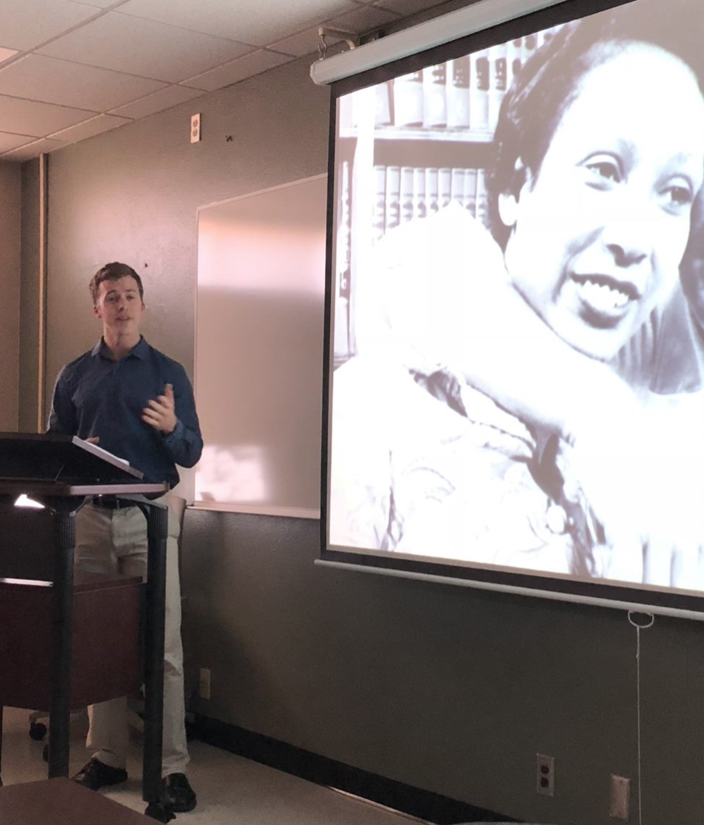
Final Thoughts on Abstracts
For the December deadline, you do not need data completed (for the conference, you do)
Approximately 85% - 90% of abstracts are typically accepted.
Not accepted abstracts typically:
  Do not adhere to the guidelines
  Are jumbled, poorly written, unorganized
  Are very short or exceed the word limit
  Do not seem to adhere to the definition of undergraduate research: http://www.cur.org/who/organization/mission/

Slide 20
Thank You!
Questions or comments?
ncur2019@kennesaw.edu

Slide 21
Outside Resources
https://bakercatherine.wordpress.com/2017/03/15/how-to-write-a-conference-abstract-a-five-part-plan-for-pitching-your-research-at-almost-anything/
https://theprofessorisin.com/2011/07/12/how-tosday-how-to-write-a-paper-abstract/
https://urc.ucdavis.edu/conference/write.html

